Slide 1

Microprocessors Lab SIMON GAME
Submitted to : Ms. Rayana Jaafar
Presented by:
Clara Akiki
Joseph Attieh

Slide 2
Task 1
Objective 1: “Simon Game” should be scrolling to the RIGHT while welcome is on the second line
Solution:
X ← Simon Game A ← OFFSET
LDAB A, X
Print on LCD
Increment OFFSET
CMP with length
If 0 → OFFSET = 0
Increment POSITION
CMP with #8
Beginning of line ( #$80)
Clear POSITION
Decrement COUNTER
Go to second line (#$A8) and Print Welcome
Store Counter in Offset
CMP with #5
If not 8
If not 5

Slide 3





Objective 2: “Simon Game should be scrolling for 3 seconds only”
Solution: Changing the delay used by SENDDATA and SENDINSTR
→ delay uniformly distributed between the characters
→ all the message takes 3 seconds
Number DC.B 0
DELAY PSHX
LDX (any nbr)
DBNE X, *
INC Number
PULY
RTS
MCU speed = 2𝑀𝐻𝑧
1 cycle → 1/2𝑀=0.5 𝜇𝑠
? ? → 3 seconds
$$\frac{3}{0.5μ}= 6×{10}^{6} cycles$$
Number of times we enter the delay function in previous code : 249 times
249 delays → $6×{10}^{6} cycles$
One delay → ??
One DBNE → 3 cycles
?? → $24 096$ cycles
$$\frac{6×{10}^{6}}{249}≈24 096 cycles$$
$$\frac{24 096}{3}≈8032$$
Stored in X

Slide 4
Objective 3: “Pick the level of difficulty ” should be scrolling to the LEFT
Solution (like in the lab):
X ← Pick the level of difficulty B ← OFFSET
LDAA B, X
Print on LCD
Increment OFFSET
CMP with length
If 0 → OFFSET = 0
Increment POSITION
CMP with #8
Beginning of line ( #$80)
Clear POSITION
Increment COUNTER
CMP with length
Clear COUNTER
Store Counter in Offset
Code to check Push Buttons (NEXT)
If not 8
Keeps branching until a button is pressed
If not equal

Slide 5
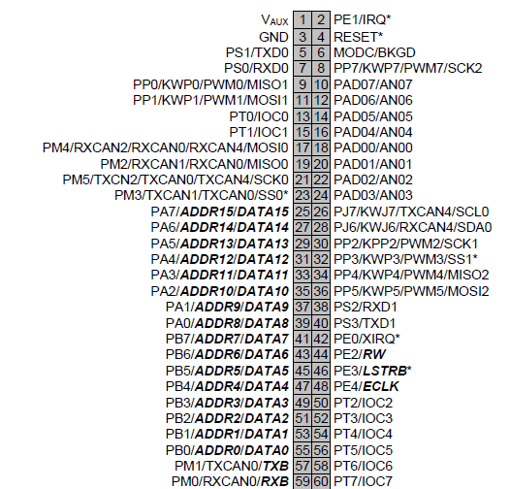
Objective 4: The program should wait for the user to press a Button
Solution: check Push Buttons
Push Button connected to PORT B
Push Button 1 → PB0
Push Button 2 → PB1
Push Button 3 → PB2
to check if we pressed:
Push Button 1 → Check if PB0 is 1 BITA #1
If equal go to EASY
Push Button 2 → Check if PB1 is 1 BITA #2
If equal go to MEDIUM
Push Button 3 → Check if PB2 is 1 BITA #3
If equal go to HARD

Slide 6
Objective 5: Starting sequence length should be initialized to 5, 10 and 15 while displaying the selected level on the first line of the LCD. A countdown from 3 to 1 is displayed on the second line
Solution:
Create a variable in memory called LEVEL
Initialize this variable in EASY, MEDIUM AND HARD
→ EASY : move 5 to LEVEL
print on the screen EASY
→ MEDIUM : move 10 to LEVEL
print on the screen MEDIUM
→ HARD: move 15 to LEVEL
print on the screen HARD
print a countdown (second line: #$A8)
Create a value in memory called CDOWN that holds number 3
A ← CDOWN
add 48 to get ascii
print on the screen
decrement CDOWN
CMP with 0
If not equal

Slide 7
Task 2
Objective 1: Create a subroutine that generates one random number at a time
Solution:
Load MCCNT with a big value (we disable interrupts)
Branch to subroutine of a Customized Delay
Instead of loading a fixed value in X, we load MCCNT
D ← MCCNT
X ← 4
Divide D by X and get remainder in D ( 0, 1 ,2 or 3)
Add one to the remainder (1,2,3 or 4)
(The random number will be located in register B)
DELAYCUST
X ← MCCNT
DBNE X , *

Slide 8
Objective 2: A sequence of random numbers should be generated depending on the LEVEL
Solution:
Create a variable in memory called SEQUENCE (pointer)
X ← #SEQUENCE A ← offset
generate a random number (it is in B)
STAB A,X
increment offset
CMP with LEVEL
If not equal

Slide 9
Task 3
Objective: light the corresponding LEDs according to the combination generated by the random number generator subroutine
Solution:
X ← #SEQUENCE B ← offset
Compare offset with length
LDAA X,B (the number generated previously)
CMP with #1 if equal light LED1 and turn off all LEDs
else CMP with #2 if equal light LED2 and turn off all LEDs
else CMP with #3 if equal light LED3 and turn off all LEDs
else CMP with #4 if equal light LED4 and turn off all LEDs
Increment offset
branch to beginning
If equal, exit

Slide 10
Task 4
Objective 1: The user should be able to type the sequence and we should compare it with the numbers previously generated
Solution
while bit 5 (Receive Data Register Full Flag) of SCI0SR1 is 0 recheck until it become 1
X ← #SEQUENCE B ← offset
LDAA B,X (the number generated previously)
ADD 48 to get the ASCII equivalent
CMP with contents of SCI0DRL (input from user)
if not equal, go to FALSE (user made a mistake no need to keep checking)
Clear Status register (Read SCI0SR1 and SCI0DRL) to receive another character
CMP offset with length if equal, go to TRUE (user entered all the sequence without branching to FALSE)
Branch to beginning

Slide 11
Objective 2: If the user sends any wrong answer, we should display “You Lost” then loop back to the starting point of the program. Else, if the user enters the correct combination, display “Correct” on the first line of the LCD and proceed to increase the sequence length by 1.
Solution:
If the user wins:
Clear screen and print “Correct”
Increment LEVEL
Print “Be Ready”
Jump to where we generated random
numbers (task 2)
If the user loses:
Clear screen and print “You lost”
Jump to the start of our program

Slide 12
Bonus
Objective 1: Play a sound of the buzzer each time the user wins and looses
Solution:
Enable the Buzzer as an output on PORT T
Create a counter with a given value
Change the frequency of the buzzer by :
setting bit corresponding to the buzzer to 1
delay
set bit corresponding to the buzzer to 0
delay
Decrement counter
CMP with 0
We change the tone of the two subroutines by changing the frequency (the delay)
If not 0

Slide 13
Objective 2: Use colorful LEDs
Solution:
Connect LEDs to PORTB and remove jumpers
LED4 is connected to PB7
LED3 is connected to PB6
LED2 is connected to PB5
LED1 is connected to PB4
Each time in our code we want to use a LED:
set bit corresponding to LED to 0 → LED is off
set bit corresponding to LED to 1 → LED is on

Slide 14

Difficulties encountered

Slide 15
Difficulty 1
Displaying Simon Game and Welcome for only 3 seconds without using interrupts
Solution:
Tried first to vary the delay using trial and error.
Used delay that took a lot of effort and work to determine the value to load in the register (defining the delay) in order to display for exactly 3 seconds.

Slide 16
Difficulty 2
Making the random generator fully randomized
Solution: Created a subroutine that only generates one random value and contains a customized delay. In the main code, we jumped to that subroutine to create the sequence of numbers.

Slide 17

Difficulty 3
Changing the sequence of random numbers every time it is increased when the player wins (it repeats the same sequence then it adds a number)
Solution: Clearing the offset after generating the sequence

Slide 18

Difficulty 4
Entering a sequence of values in putty instead of entering value per value
Solution: Cleared the SCI status register 1 and SCI data register

Slide 19
Thank you !

